Slide 1
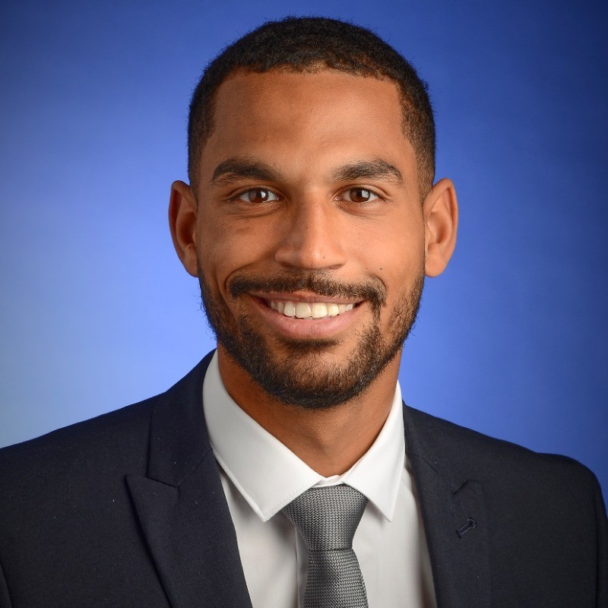
Ayo Owoborode
Mini Bio
Ayo is a data-driven professional with advanced expertise in SQL, Python, SAS, and Excel, skilled in extracting and analysing complex datasets to deliver actionable insights. Ayo has a strong track record in developing detection systems, leading data platform transitions, and conducting in-depth trend and root cause analyses to support strategic decision-making. With experience in risk assessment, compliance analytics, and cross-functional collaboration, Ayo excels at translating data into clear business strategies. Ayo is also passionate about mentoring, consistently helping team members enhance their analytical skills and use of data tools to drive operational efficiency and impact.
Experience
Advanced data analytics proficiency using SQL, Python, SAS, and Excel to extract, manipulate, and interpret large datasets for actionable insights.
Developed and optimised detection rules and monitoring systems, proactively identifying emerging patterns and reducing risk exposure.
Led the transition of data monitoring platforms, enhancing rule logic efficiency and improving overall data processing capabilities.
Conducted in-depth trend analysis and root cause investigations using behavioural data, supporting strategic decision-making and mitigation.
Delivered data-driven recommendations to financial institutions on improving financial crime compliance, including transaction monitoring and sanctions screening.
Translated complex data into clear, strategic business insights for senior stakeholders across risk and compliance teams.
Enhanced strategies by applying data modelling and analytics to identify high-potential targets and streamline integration processes.
Worked with sensitive data to assess potential risks, applying analytical rigour and domain-specific knowledge to support informed decision-making.
Experience in cross-functional environments, using data to support legal, operational, and technical objectives in fast-paced industries.
Conducted detailed reviews of contracts and legal documents to identify potential risks, obligations, and areas for optimisation.
Provided clear summaries of contractual terms and implications to stakeholders, supporting informed decision-making across projects.
Skills
Technical Skills: Proficiency in SQL, Python, Power BI, SAS, and Microsoft suite (including Excel) for data analysis, building predictive models, and visualising insights. Utilisation of technical tools to combat fraudulent activities effectively within financial crime contexts.
Analytical Skills: Expertise in data analytics, mergers and acquisitions, market research, and financial modelling. Ability to analyse vast datasets, identify patterns, and derive actionable insights to address complex challenges.
Qualifications
University of Kent
Postgraduate Diploma Economics
BPP Law School
LLM Law
University of Bristol
Bsc(Hons) Sociology

